Slide 1
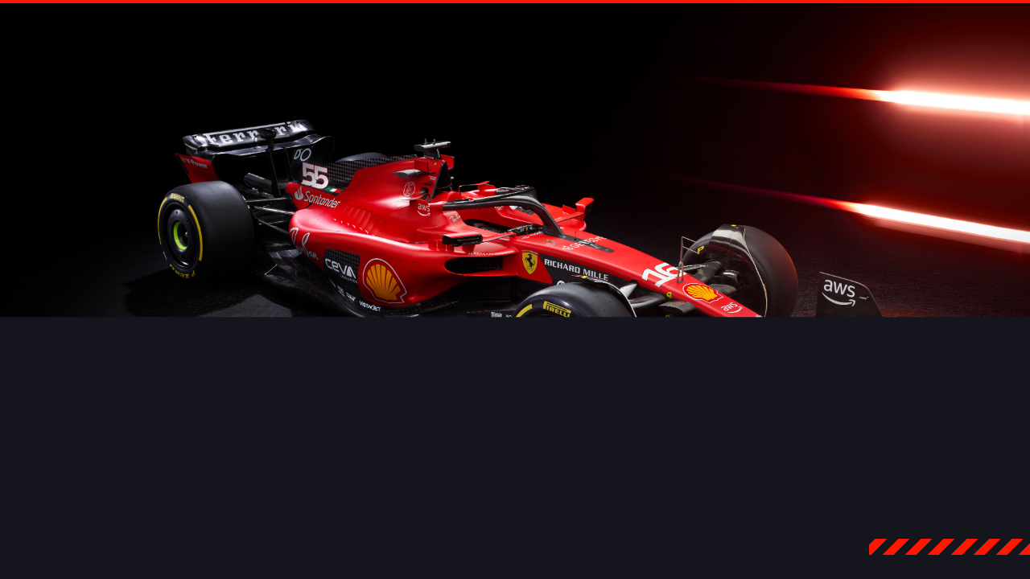

OPTIMIZING F1 LOGISTICS
CO₂
The Traveling Salesman Problem

Slide 2

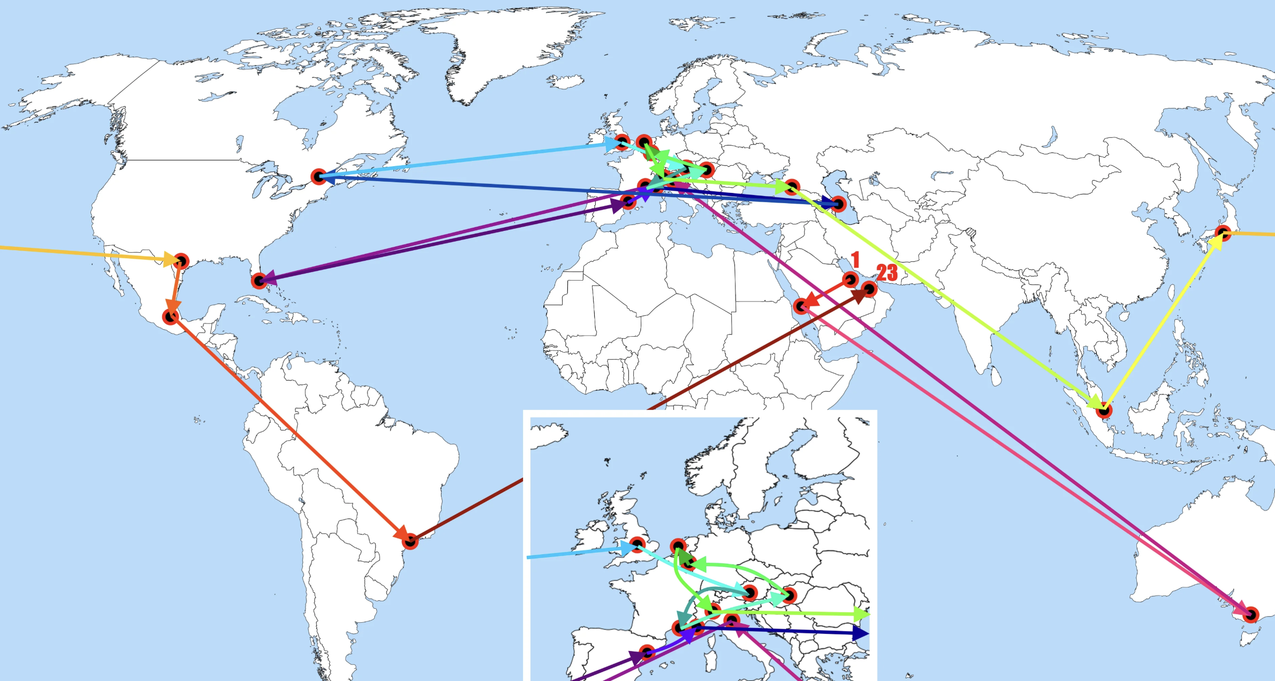
LOGISTIC NIGHTMARE
THE CURRENT REALITY
24 races in 11 months around the globe.
The route resembles a wild zigzag course.
Example: Australia → China → USA → Italy
4 Continents within the first 7 races
The Problem:
massive inefficiency
unnecessary CO₂ emissions

Slide 3


THE TRAVELING SALESMAN PROBLEM
THE CHALLENGE
How to find the perfect route?
about 12.9 SEXTILLION
“12 926 008 369 442 488 320 000”
Astronomical number
→Manual trial and error is impossible.
Our Goal: Ignore politics, apply mathematics.

Slide 4

Strategy
STRATEGIC DECISION
Beginning: Nearest Neighbour Heuristic.
Later: Successive Insertion Heuristic.
Why NN : F1 transport must minimize immediate travel time.
→ closest next destination is the most intuitive approach
to reduce transit between races
Successive Insertion:
optimizes the global route structure
→ by evaluating the cost of adding a destination between existing stops
→ rather than just moving to the closest point
→ prevents inefficient "long-distance jumps" at the end of the season.

Slide 5

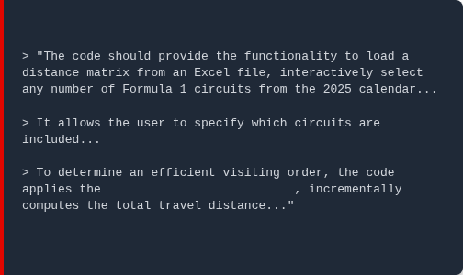

ALGORITHM & AI INTEGRATION
BASIS & STARTING POINT
Foundation: Official F1 2025 Calendar sequence.
Fixed Start: Australia (Melbourne).
CHATGPT SYSTEM PROMPT (SNIPPET)
This constraint ensures the algorithm respects the traditional season opener, creating realistic travel chains rather than theoretical constructs.
ITERATIVE DEVELOPMENT
Nearest Neighbor heuristic
Prompt Engineering: Using specific, constraint-based prompts (see left) to generate the Python core.
Manual Testing: Ran tests with small subsets (4 tracks) to verify the logic manually against calculator results.
Optimization Loop: Refined the code with AI assistance until the output matrix perfectly matched validated distances.

Slide 6
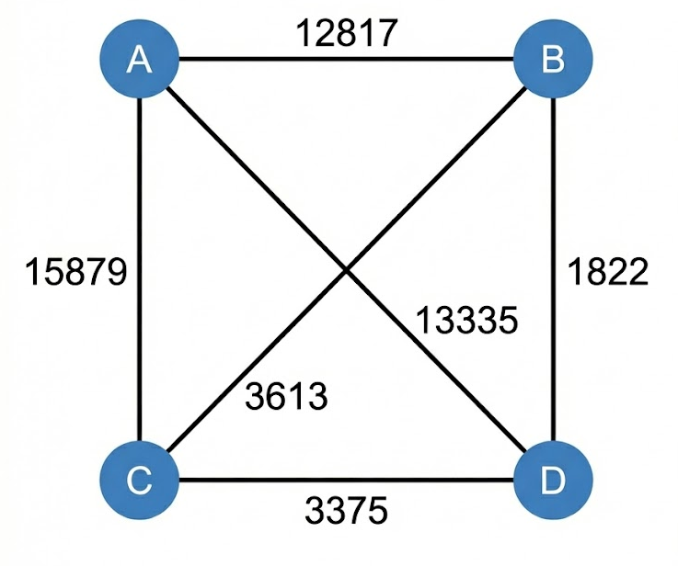
MANUAL PROOF OF CONCEPT
VERIFYING THE LOGIC
We didn't blindly trust the computer. We verified the algorithm's logic by hand with a 4-city test case.
→ Here NN for example
A: Start: Melbourne
B: Next: Jeddah
C: Then: Red Bull Ring
D: End: Baku
The algorithm does the exact same thing, just incredibly fast for all 24 races (NN and SI)

Slide 7
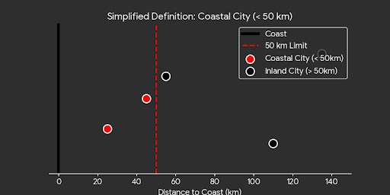

ASSUMPTIONS: COASTAL DEFINITION
To be able to use sea freight, we must define when a route is considered "coastal".
THE 50KM RULE
Anything closer than 50 km to a port is considered "Coastal".
Example Brazil: Interlagos is inland, but the port of Santos is just under 50km away → We count this as "coastal"

Slide 8


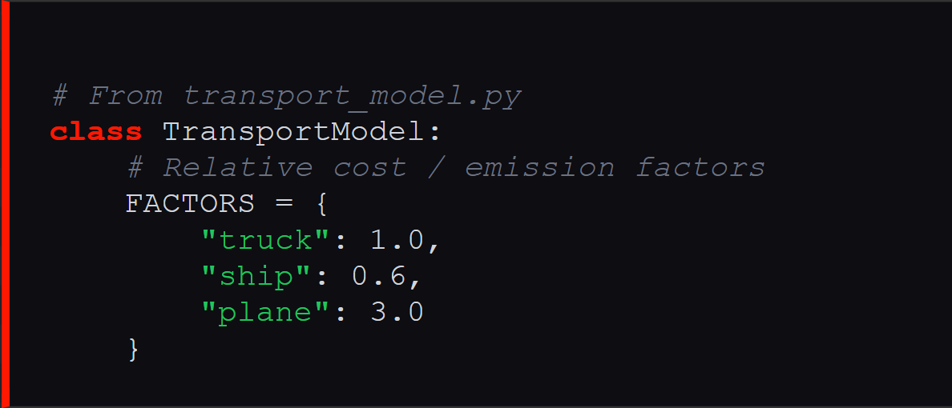
THE ECO-MODEL
SHORTEST ROUTE ≠ CHEAPEST ROUTE
COST FACTORS (CODE)
Our model differentiates between transport modes to minimize the ecological footprint.
Relative Cost Modeling: Instead of volatile market prices, the model uses fixed cost-factors to identify the most efficient logistics ratio.
Air Freight: Fast, but extremely expensive and high emissions.
Truck: For short distances on the same continent.
Sea Freight: Slow, but massively cheaper and more CO₂-efficient.

Slide 9
The Strategic Cost Model
To mirror real-world F1 logistics, we evolved our model from simple distance to a multi-dimensional cost function.
Speed vs. Cost (The Trade-off)
Time via "Time Multiplier": a speed factor to calculate travel time for a plane (e.g., factor of 0,15 = a 1,000 km flight is "perceived" as 150 km by the algorithm, making planes appear closer and more attractive when speed is the priority
Cost via Linear & Non-Linear Functions: Each mode is assigned a cost function consisting of a fixed base fee plus a variable rate per kilometer. While trucks use a simple linear cost, the plane function includes logarithmic scaling and fuel weight penalties to reflect realistic long-haul aviation expenses.
Cost via Strategic Functions: Every trip calculates a "ticket price" for both truck and plane using a fixed fee plus a variable rate per kilometer. By adjusting weights, the user decides if the model should prioritize cost (mostly favors Trucks) or the highest speed (Planes)

Slide 10
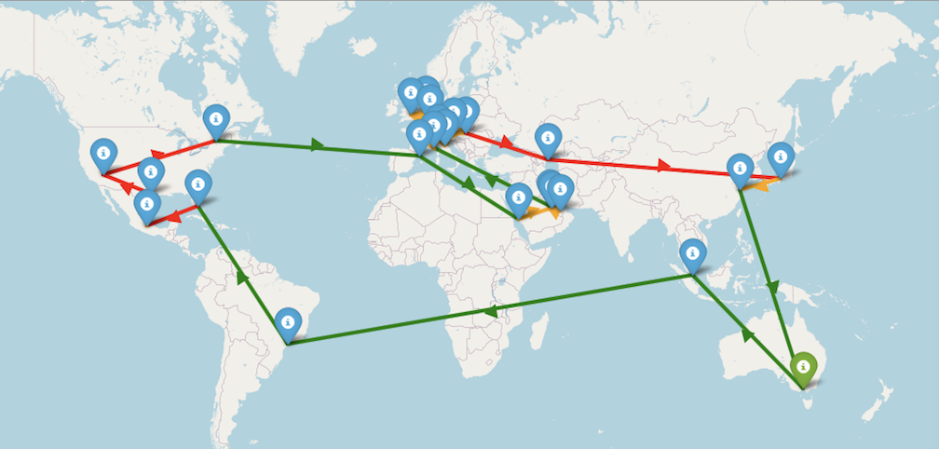
7. RESULT: 2025 SEASON
Results: Eco Successive Insertion Plot

Slide 11
7. RESULT: 2025 SEASON
Results
Model Type | Roundtrip (Yes) | Roundtrip (No)
Benchmark (Direct) | 125,789 km | 114,148 km
Nearest Neighbour (NN) | 62,629 km | 49,130 km
Cheapest Insertion (IH) | 68,533 km | 62,257 km
--- | --- | ---
Multimodel: time and cost: (NN) | 62,629 km / € 7,560,837 | 49,130 km / € 6,909,247
Multimodel: time and cost: (IH) | 67,554 km / € 7,622,663 | 67,341 km / € 7,620,024
--- | --- | ---
Eco_NN | 78,147 km | 65,270 km
Eco_IH | 73,793 km | 65,714 km

Slide 12





WHY DOESN'T F1 DO THIS?
MONEY
WEATHER
CONTRACTS
Organizers like Abu Dhabi pay millions extra to host the prestigious season finale.
Our mathematically optimal route would lead F1 to Canada in March – right into the snow.
Many dates are historically grown or politically fixed and cannot be moved.

Slide 13


CONCLUSION
Mathematically, the problem is solved. We could revolutionize logistics.
"In reality, commerce often beats mathematics."

